Slide 1
CNet: Making Your Hall Pay Its Way
24 September 2025

Slide 2

Outline for morning
Introductions:
Two truths & a tall tale
Income generation
BREAK
Discussion:
From firefighting to forward thinking
Reflection
Activity: Golden goose
Resources and further support

Slide 3
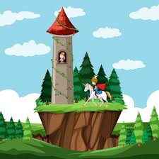
Two Truths and a Tall Tale
Introductions and icebreaker

Slide 4

Firefighting to Forward Thinking
Internal
(Issues we can control)
External
(we can’t control but can adapt to)
Notes:
Take post it notes on Biggest Challenges Sheets and discuss if issue is internal or external, divide onto two flipchart sheets, internal/external
What is the biggest drain on your resources right now?
Areas to be discussed, hopefully in line with issues raised on Biggest Challenges exercise:
Pricing
Review hire charges regularly
Cashflow Forecasts
Promotion
Use Social Media
Effective website
Improving facilities and increasing bookings:
Facilities - Good heating, good acoustics, relaible Wifi, accessible toilets, modern kitchen
Mapping out bookings to identify gaps
Research what other village halls in your area offer
Working with CFY to secure funding to improve facilities.
Engaging your community:
Community Consultation
Mini Steering groups for planning events & activities
Partner with local businesses/Sponsorship of events
Managing Costs:
Volunteer skill-sharing (marketing, bookkeeping, repairs)
Insurance
Utility Bills - Utility Aid, 5% VAT on electric/gas bills

Slide 5

The Golden Goose
Maximum Income, Minimum Effort
Activities and events which have brought in a good amount of money for little work/stress

Slide 6

COFFEE BREAK

Slide 7

What else is out there?

Slide 8


Notes:
Upcoming gift aid training session. 6th October 2025 1pm – 3pm
Reclaim 25p for every £1 donated

Slide 9

Corporate Match Funding Schemes
Barclays
Asda
Card Factory
Argos
Vodaphone
Shell
BT
BP
Co-op
Marks and Spencers
Lloyds TSB
WHSmiths
British Gas
SPAR

Slide 10

Legacy Donations

Slide 11

Host a Parcel Locker or Recycling Bin
InPost Lockers
https://inpost.co.uk/business/host-a-locker
Amazon Lockers
https://www.amazon.com/b?ie=UTF8&node=13853235011
Printer Ink Recycling
https://www.emptiesplease.com/
Clothing Recycling Bins
https://www.bag2school.com/

Slide 12
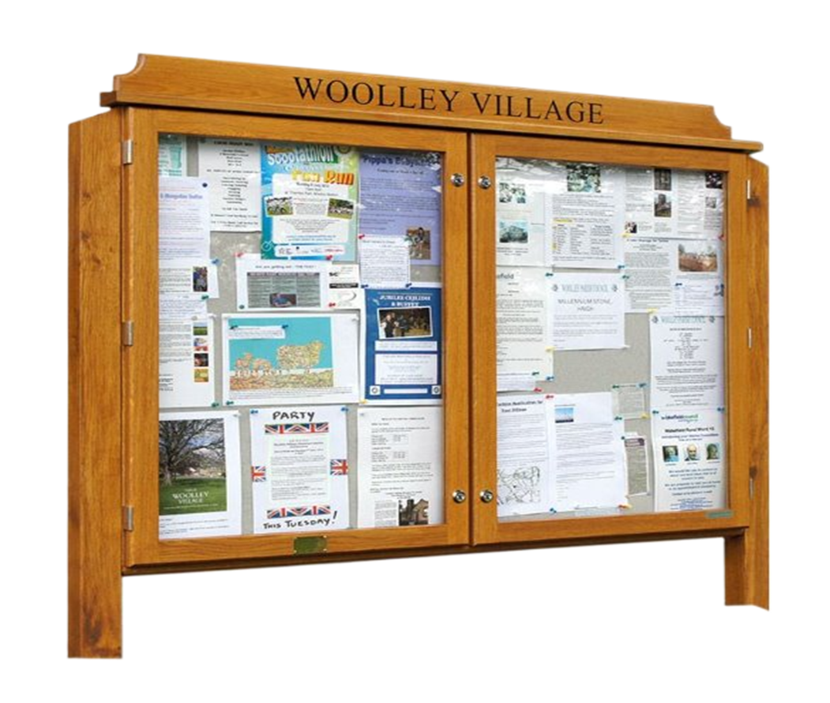
Sell Advertising Space
Notes:
Newsletters, Facebook promotions,

Slide 13
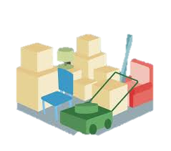
Sell Storage Space

Slide 14

Car Parking Charges
Notes:
Also possibility of obtaining grant funding for installation of electric vehicle chargers and charging for community use.

Slide 15

Grant Funding
Notes:
Handout – current grants for village hall projects
Grants could be for trialling new activities, making improvements to the hall to increase the usage, installing systems which may save time and money such as HIVE heating control system, insulating the hall, new windows etc or income generation from electric car charging points.

Slide 16

Open Discussion
Reflection on the session / Issues arising

Slide 17

Resources and Support
Community First Yorkshire Resources:
An Easy Guide to Community Engagement
A-Z Fundraising Ideas
Grant Funding for Village Halls Info. Sheet
Cashflow Forecast
Lockers
For one-to-one support contact us via our online form or phone our office on 01904 704177

Slide 18
Next meeting:
22nd January 2026
How to build and manage your own website

Slide 19

Upcoming Training
Getting Started with Gift Aid 6 October 1pm-3pm
Basic Bookkeeping using WYCAS Cashbook 8 October 10am-1pm
Budget and Cashflow Forecasting 4 November 10am - 1pm
Safeguarding Responsibilities for Trustees 17 November 6pm-7pm
National Lottery Awards for All 25 November 1pm-2:30pm
Financial Reporting for Trustees 2 December 2pm-4pm

Slide 20


